Slide 1

Credit Card Default Prediction
By Naveen Sanapala

Slide 2
Problem Statement
Financial threats are displaying a trend about the credit risk of commercial banks as the incredible improvement in the financial industry has arisen. In this way, one of the biggest threats faced by commercial banks is the risk prediction of credit clients.
The goal is to predict the probability of credit default based on credit card owner's characteristics and payment history.

Slide 3
Tools used
Google Colab
Matplotlib
Scikit-learn
Pandas
Seaborn
Python
Imblearn
xgboost

Slide 4
Data
I have loaded the data into the Google Colab notebook using pandas Library.
Dataset Information
This dataset contains information on default payments, demographic factors, credit data, history of payment, and bill statements of credit card clients in Taiwan from April 2005 to September 2005. Content There is 25 Variable:
ID: ID of each client
LIMIT_BAL: Amount of given credit in NT dollars (includes individual and family/supplementary credit
SEX: Gender (1=male, 2=female)
EDUCATION: (1=graduate school, 2=university, 3=high school, 4=others, 5=unknown, 6=unknown)
MARRIAGE: Marital status (1=married, 2=single, 3=others)
AGE: Age in years
PAY_0: Repayment status in September, 2005 (-1=pay duly, 1=payment delay for one month, 2=payment delay for two months, ... 8=payment delay for eight months, 9=payment delay for nine months and above)
PAY_4: Repayment status in June, 2005 (scale same as above)

Slide 5
PAY_5: Repayment status in May, 2005 (scale same as above)
PAY_6: Repayment status in April, 2005 (scale same as above)
BILL_AMT1: Amount of bill statement in September, 2005 (NT dollar)
BILL_AMT2: Amount of bill statement in August, 2005 (NT dollar)
BILL_AMT3: Amount of bill statement in July, 2005 (NT dollar)
BILL_AMT4: Amount of bill statement in June, 2005 (NT dollar)
BILL_AMT5: Amount of bill statement in May, 2005 (NT dollar)
BILL_AMT6: Amount of bill statement in April, 2005 (NT dollar)
PAY_AMT1: Amount of previous payment in September, 2005 (NT dollar)
PAY_AMT2: Amount of previous payment in August, 2005 (NT dollar)
PAY_AMT3: Amount of previous payment in July, 2005 (NT dollar)
PAY_AMT4: Amount of previous payment in June, 2005 (NT dollar)
PAY_AMT5: Amount of previous payment in May, 2005 (NT dollar)
PAY_AMT6: Amount of previous payment in April, 2005 (NT dollar)
default.payment.next.month: Default payment (1=yes, 0=no)

Slide 6
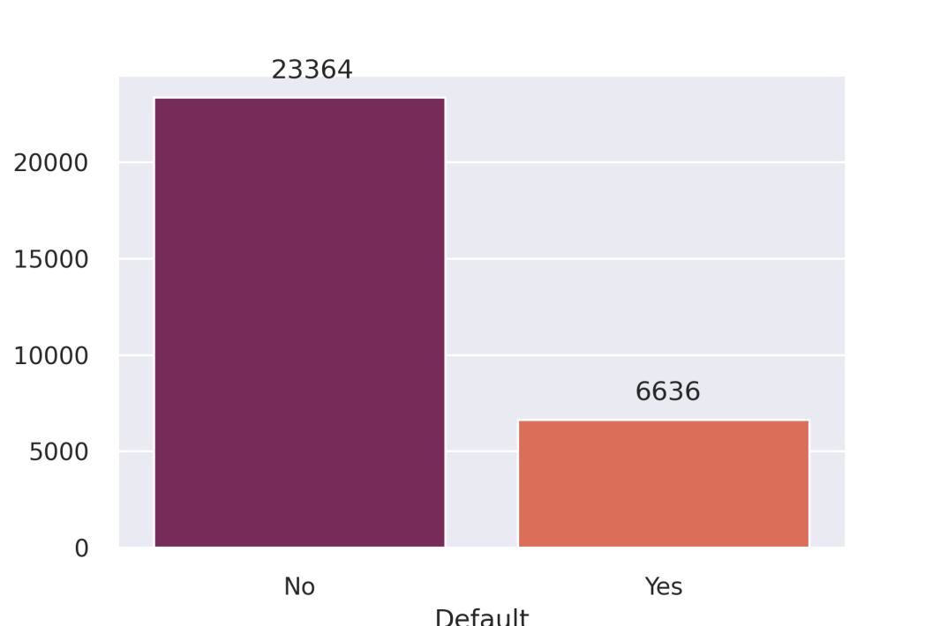
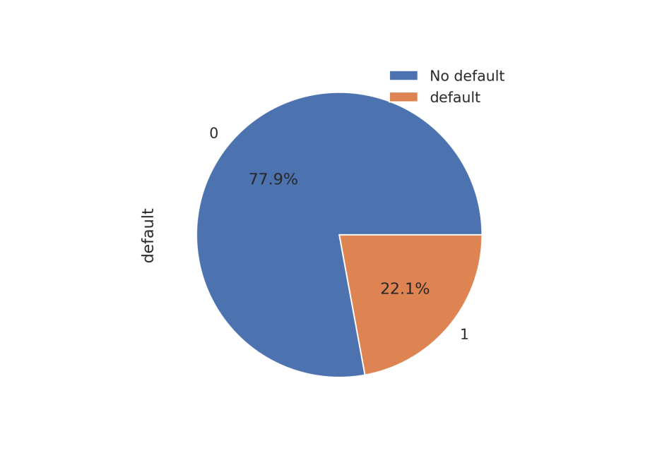
Approach
As data is highly imbalanced , I have used SMOTE technique for oversampling the minority class.
You can check the below pictures which illustrate the imbalanced data.

Slide 7
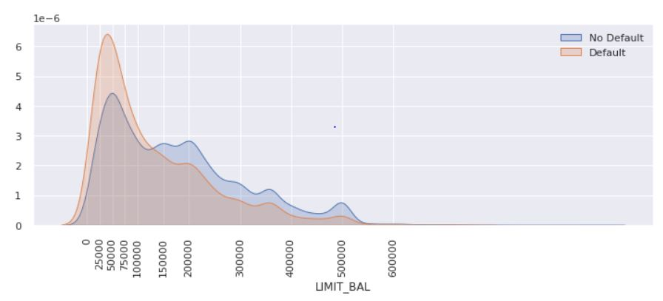
Limit_bal
We noticed that LIMIT_BAL (Amount of given credit in NT dollars) has some effect on the credit default.
We can see a pattern where credit default is high when the LIMIT_BAL is low (less than 1,50,000).
You can notice the same from the below fig.

Slide 8
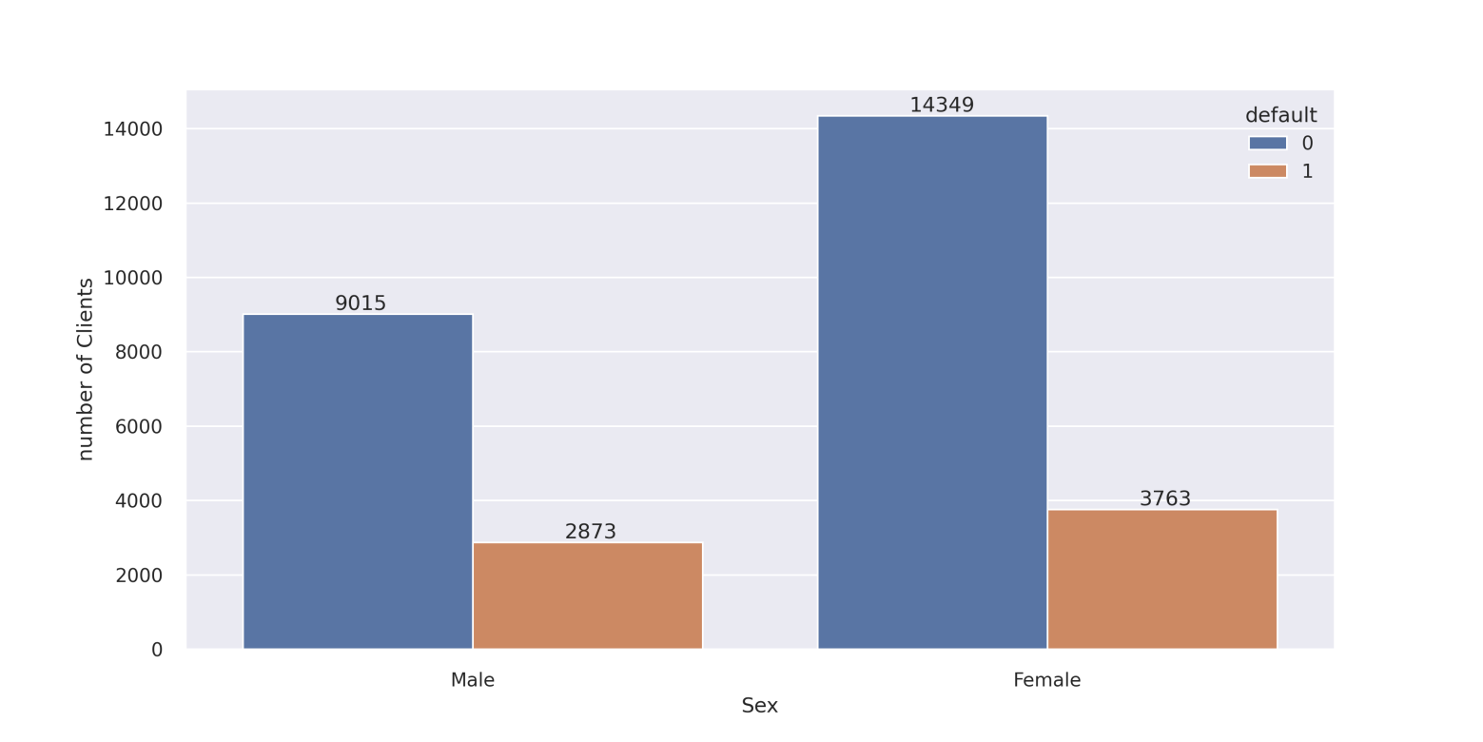
SEX
We can notice that the number of Women is high in the data set , though the number of defaulter in women is high , we can easily see that percentage of defaulter in Men is high.

Slide 9
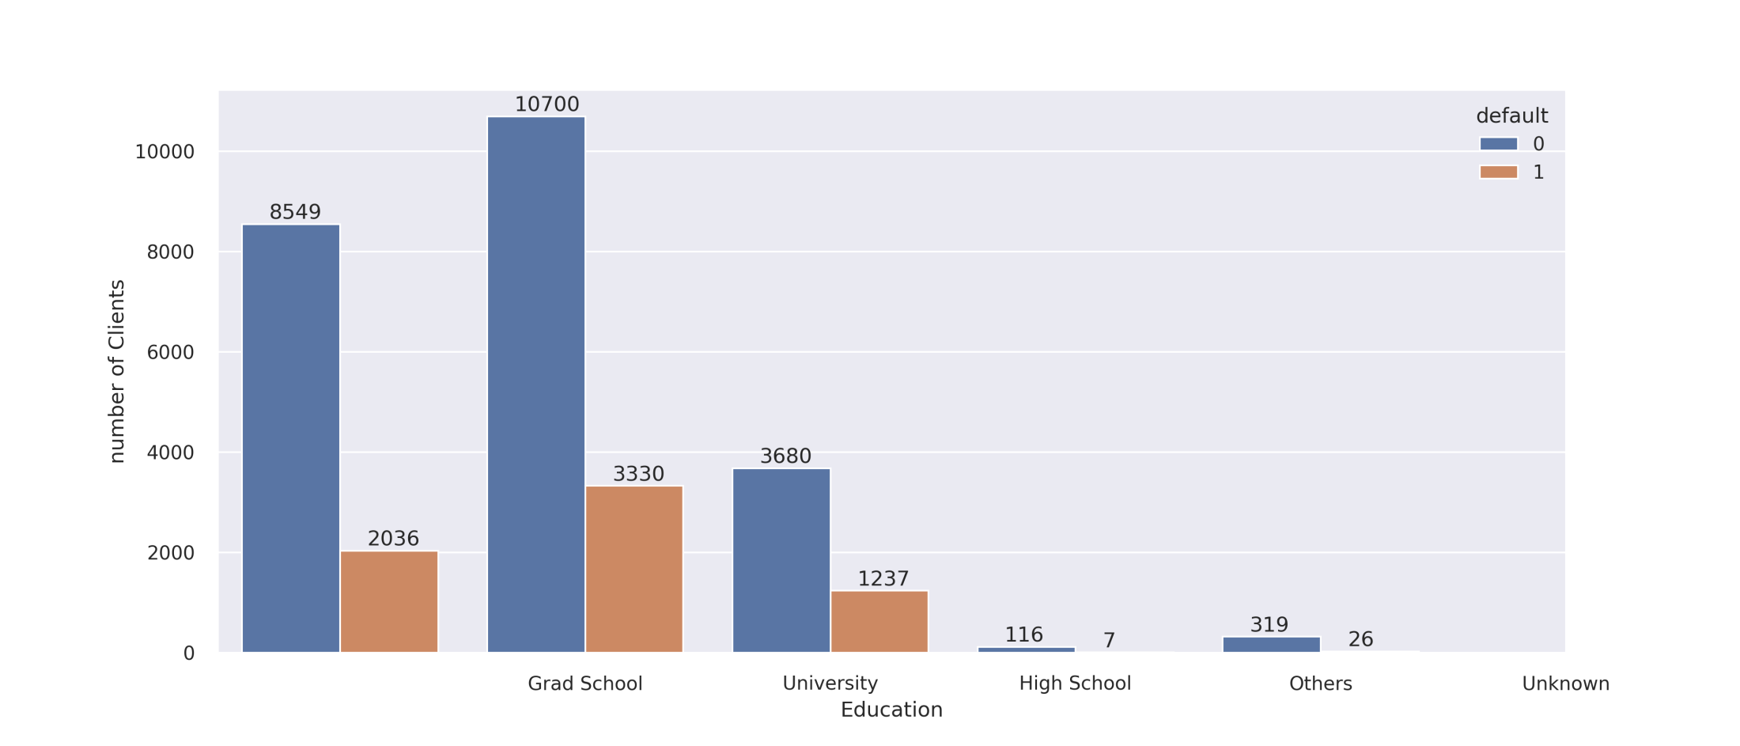
Education
We can see clients having education qualifications as University,Gratuate school, High school are high in number of defaulters.

Slide 10
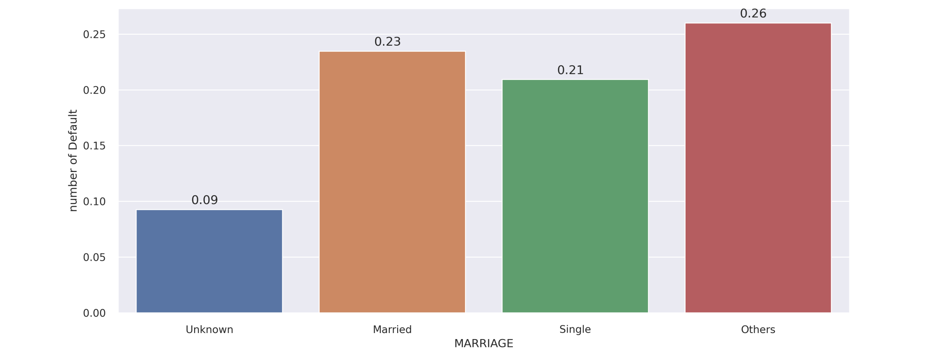
Marriage
We can notice most clients who defaulted are from Others, Married and Single categories.
If , we consider Others as Divorced, It is highly likely that the defaulters belong the category Others as mostly divorced people will have economic issues.

Slide 11
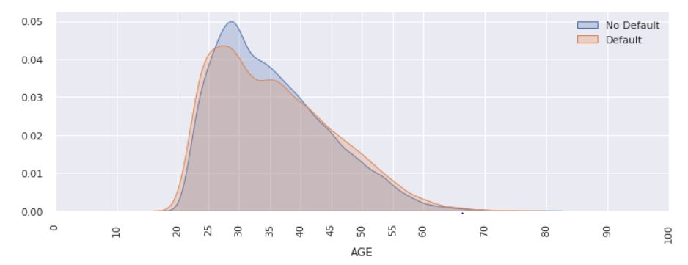
Age
We can notice that most of the defaulter clients are with the age greater than 25 and less than 40.

Slide 12
Test Train Split
I have split the data into Train and test sets using sklearn.model_selection
In order to maintain the ratio of Default and no default common both in Train and test sets . I have stratified the values of column “default” (from here in the name of “default.payment.next.month” is changed to “default” for ease in calling in the column name)

Slide 13
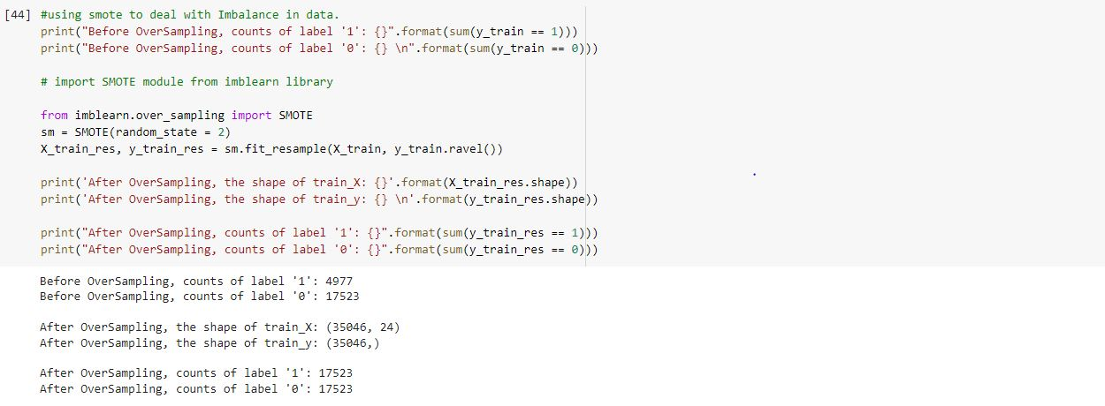
Over Sampling
As the original data is Imbalanced , I have used SMOTE to (Synthetic Minority Oversampling Technique) to over sample the Minority category.
Results after SMOTE :

Slide 14
Classification Models
XGB Classifier
Logistic Regression
SVM Classifier
Decision Tree Classifier
Random Forest Classifier

Slide 15
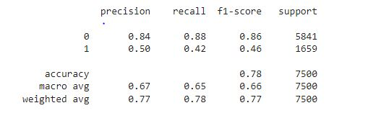
XGB Classifier
Build a XGB Classifier model with Optimal Parameters by using Grid searchCV.
Parameters used after GridSearchCV:
learning_rate=0.1,max_depth=20,n_estimators=200
We also got the probabilities for each prediction.
Classification Report :

Slide 16
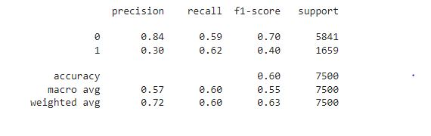
Logistic Regression
Built a Logistic Regression Model with default parameters of SK Learn library.
With the help of the model , We can classify the records and achieved to get probabilities for Default and no default labels.
Classification Report:

Slide 17
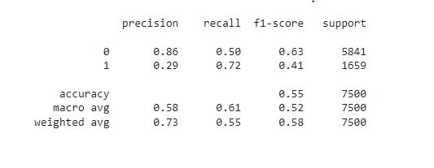
Support Vector Classifier
Built an SVM Classifier Model with default parameters of SK Learn library.
With the help of the model , We can classify the records and achieved to get probabilities for Default and no default labels.
Classification Report:

Slide 18
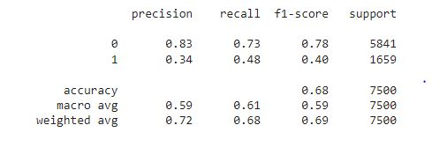
Decision Tree Classifier
Built a Decision Tree Classifier Model with default parameters of SK Learn library.
With the help of the model , We can classify the records and achieved to get probabilities for Default and no default labels.
Classification Report:

Slide 19
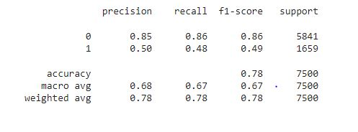
Random Forest Classifier
Built a Random Forest Classifier Model with parameters of SK Learn library.
random_state=0,n_estimators=200,max_depth=20
With the help of the model , We can classify the records and achieved to get probabilities for Default and no default labels.
Classification Report:

Slide 20
Evaluation of models
F1_Score
AUROC

Slide 21
F1_Score
On the basis of F1_score , we can notice Random forest performed well.
F1_scores :
XGB Classifier : 0.45
Logistic Regression : 0.40
SVM Classifier : 0.41
Decision Tree Classifier : 0.39
Random Forest Classifier : 0.49

Slide 22
AUROC
On comparing models based on AUROC , We can say Random Forest classifier performed well.
AUC values :
XGB Classifier : 0.74
Logistic Regression : 0.63
SVM Classifier : 0.66
Decision Tree Classifier : 0.60
Random Forest Classifier : 0.75

Slide 23
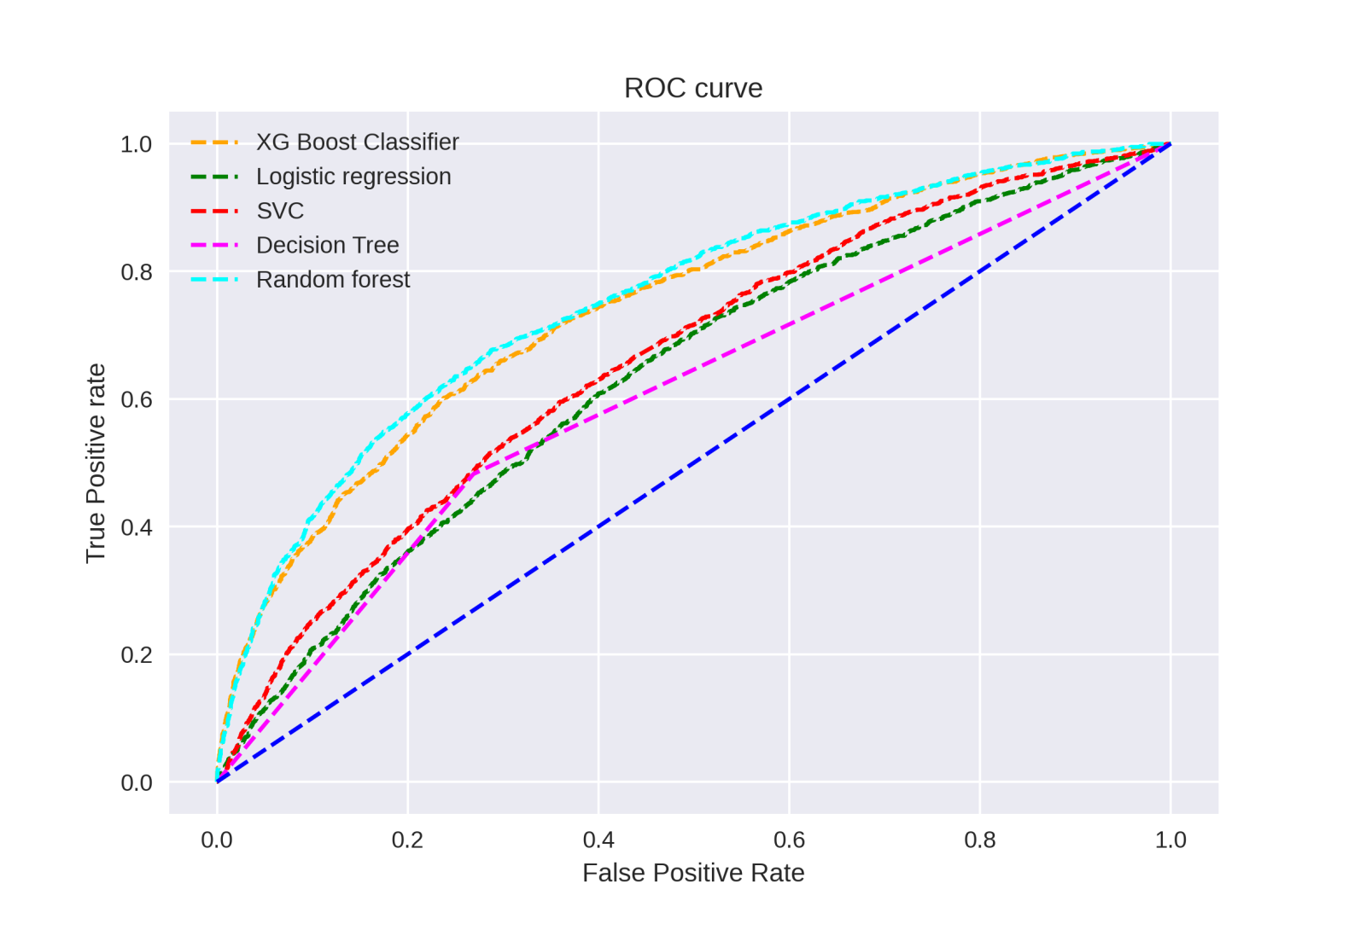
ROC Curve

Slide 24
Future Development
We can try to get better performing models by using more parameters and feature selection techniques.
We can improve the models by Standardizing the Continuous variables present in the data.

Slide 25

Naveen Sanapala
naveensanapala4@gmail.com 7095676898

